Slide 1
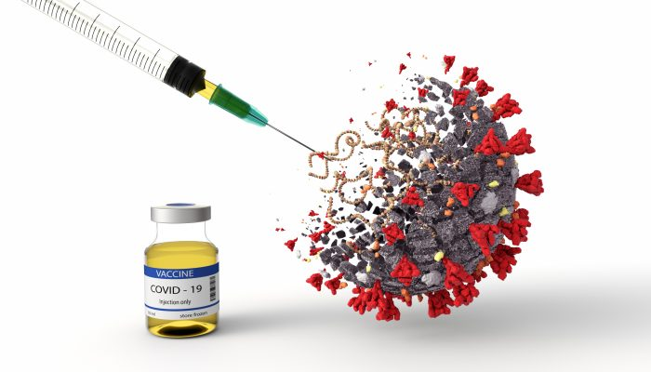
Impact of Covid-19 in Texas

Slide 2
Project Overview
The Global impact of COVID-19 has been quite significant in the past couple of years. This project mainly focuses on analyzing COVID-19 vaccination data in the state of Texas, US. Our idea is to perform data visualization based on counties and bring out informative insights from it.
Data Source
Data Cleansing Tool
Texas Department of State Health Services
Data Visualisation Tool Used
MS Excel
Version - 16.16.27
R Studio
Version - 4.2.2
Tableau Desktop
Version - 2022.4.0

Slide 3
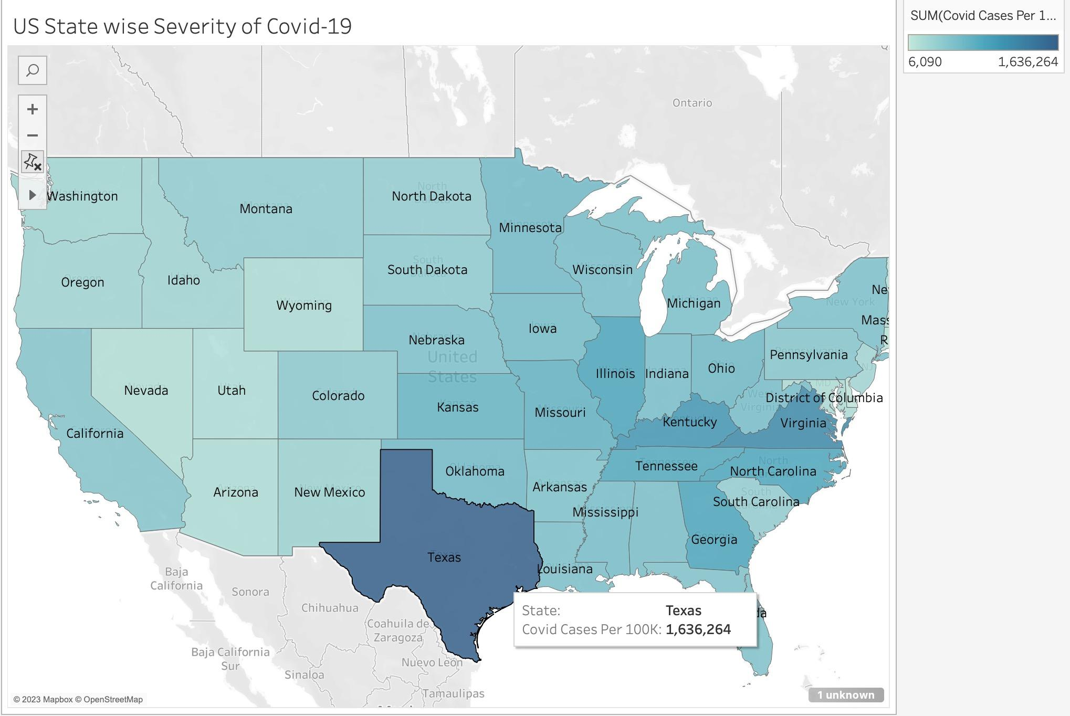
Notes:
Explanation: This hypothesis is based on the assumption that higher population densities may increase the likelihood of people coming into contact with each other, which could lead to a higher risk of infectious diseases spreading. As a result, people living in higher density areas may be more aware of the importance of vaccination and more likely to get vaccinated to protect themselves and those around them.
To test this hypothesis, data could be collected on the population densities and vaccination rates of various counties across TX. The data could then be analyzed to determine if there is a correlation between population density and vaccination rates. If the hypothesis is supported by the data, it could have implications for public health policy in TX, highlighting the need for targeted vaccination efforts in areas with lower population densities to ensure that everyone has access to the protection offered by vaccines.

Slide 4

Hypothesis 1:
In comparison to Angelina county(non-metro), it is probable that Dallas county (metro) has a higher percentage of fully vaccinated population while being 30 times more densely populated.
Notes:
Explanation: This hypothesis is based on the assumption that higher population densities may increase the likelihood of people coming into contact with each other, which could lead to a higher risk of infectious diseases spreading. As a result, people living in higher density areas may be more aware of the importance of vaccination and more likely to get vaccinated to protect themselves and those around them.
To test this hypothesis, data could be collected on the population densities and vaccination rates of various counties across TX. The data could then be analyzed to determine if there is a correlation between population density and vaccination rates. If the hypothesis is supported by the data, it could have implications for public health policy in TX, highlighting the need for targeted vaccination efforts in areas with lower population densities to ensure that everyone has access to the protection offered by vaccines.

Slide 5
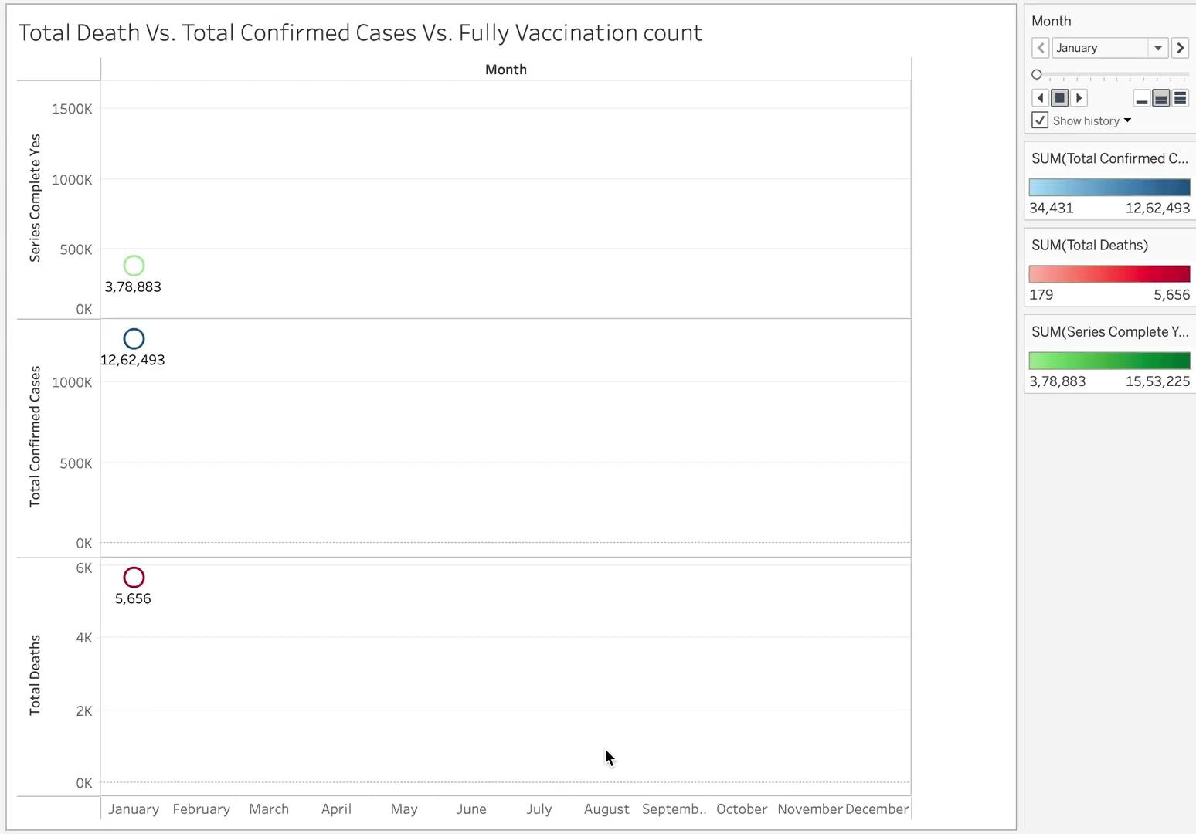
Hypothesis 2:
An increase in the number of fully vaccinated individuals could be contributing to the reduction of COVID-19 transmission and severity i.e. a decrease in number of confirmed cases & deaths.
Notes:
Explanation: As more people receive the full dosage of COVID-19 vaccines, it is expected that the number of severe cases and deaths related to the virus will decrease. This is because the vaccines have been shown to be effective in preventing severe illness, hospitalization, and death from COVID-19. When a significant portion of the population is vaccinated, it can create a protective effect, commonly known as herd immunity, which reduces the spread of the virus and protects those who may be more vulnerable to severe disease, such as the elderly or those with underlying health conditions.
With an increasing number of people fully vaccinated, there are several reasons why total deaths and confirmed COVID-19 cases may decrease:
Reduced transmission: Vaccinated individuals are less likely to spread the virus to others, as the vaccine can reduce the viral load in the body and decrease the likelihood of asymptomatic transmission.
Lower severity of illness: Even if a vaccinated individual does contract COVID-19, they are less likely to develop severe symptoms that require hospitalization or result in death. Vaccines have been shown to be highly effective in preventing severe illness and death from COVID-19.
Increased immunity in vulnerable populations: Vaccination efforts may prioritize vulnerable populations, such as the elderly or those with underlying health conditions, who are at higher risk of severe illness or death from COVID-19. As more of these individuals receive the full dosage of the vaccine, it can reduce the overall impact of the virus on these populations and lead to a decrease in total deaths.
It is important to note that other factors, such as public health measures (e.g., mask-wearing, social distancing) and natural fluctuations in the spread of the virus, can also impact the number of cases and deaths. However, the hypothesis suggests that an increase in the number of fully vaccinated individuals in a population is likely to be associated with a decrease in total deaths and confirmed COVID-19 cases due to the factors mentioned above.

Slide 6
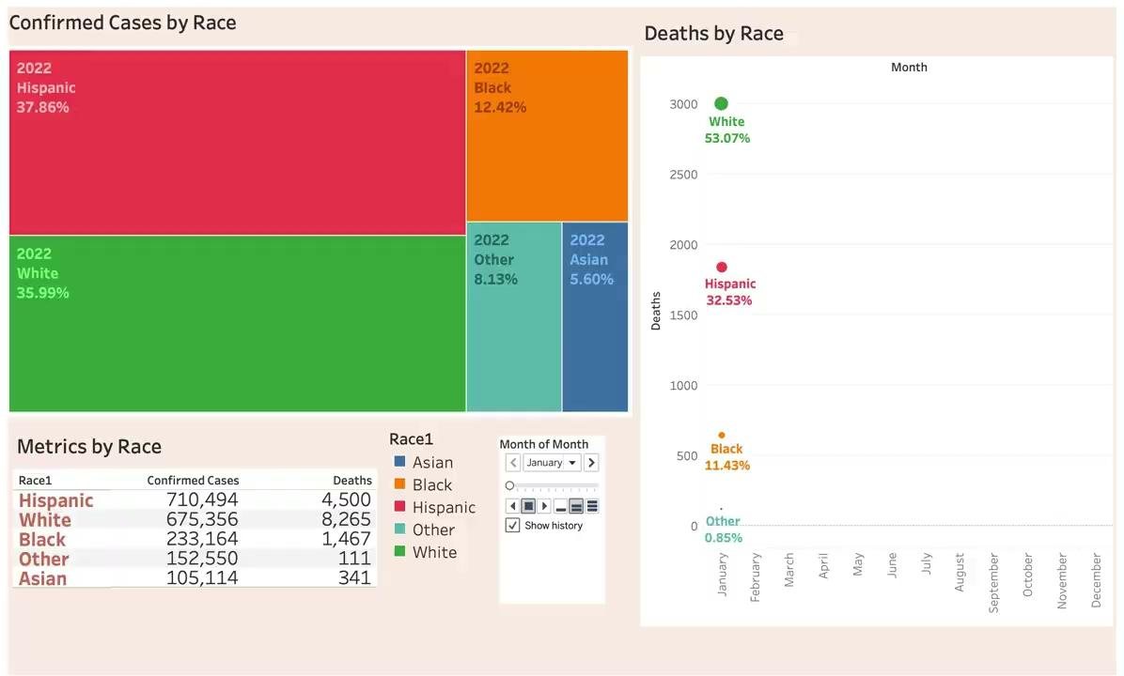
Hypothesis 3:
Despite similar numbers of confirmed COVID-19 cases, the Hispanic population experiences a 50% lower mortality rate than the White population. This lower mortality rate may be attributed to higher levels of immunity, genetic factors, or cultural practices that promote health and well-being.
Notes:
Explanation: As more people receive the full dosage of COVID-19 vaccines, it is expected that the number of severe cases and deaths related to the virus will decrease. This is because the vaccines have been shown to be effective in preventing severe illness, hospitalization, and death from COVID-19. When a significant portion of the population is vaccinated, it can create a protective effect, commonly known as herd immunity, which reduces the spread of the virus and protects those who may be more vulnerable to severe disease, such as the elderly or those with underlying health conditions.
With an increasing number of people fully vaccinated, there are several reasons why total deaths and confirmed COVID-19 cases may decrease:
Reduced transmission: Vaccinated individuals are less likely to spread the virus to others, as the vaccine can reduce the viral load in the body and decrease the likelihood of asymptomatic transmission.
Lower severity of illness: Even if a vaccinated individual does contract COVID-19, they are less likely to develop severe symptoms that require hospitalization or result in death. Vaccines have been shown to be highly effective in preventing severe illness and death from COVID-19.
Increased immunity in vulnerable populations: Vaccination efforts may prioritize vulnerable populations, such as the elderly or those with underlying health conditions, who are at higher risk of severe illness or death from COVID-19. As more of these individuals receive the full dosage of the vaccine, it can reduce the overall impact of the virus on these populations and lead to a decrease in total deaths.
It is important to note that other factors, such as public health measures (e.g., mask-wearing, social distancing) and natural fluctuations in the spread of the virus, can also impact the number of cases and deaths. However, the hypothesis suggests that an increase in the number of fully vaccinated individuals in a population is likely to be associated with a decrease in total deaths and confirmed COVID-19 cases due to the factors mentioned above.

Slide 7
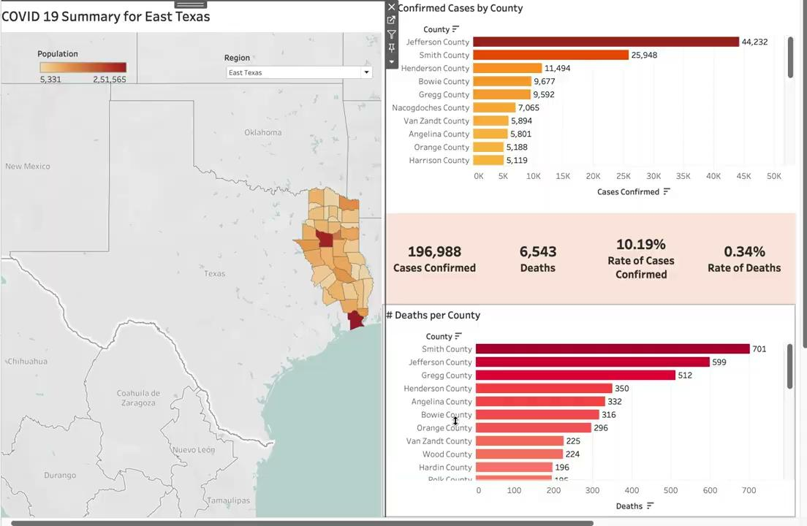
Hypothesis 4:
Death rate in East Texas is slightly higher than the overall death rate of Texas, despite a lower percentage of confirmed cases.
Notes:
Explanation: This hypothesis is based on the assumption that the number of confirmed cases of a disease in a region is an indicator of the level of transmission of the disease in that region. If a region has a higher rate of confirmed cases, it could mean that the disease is spreading more rapidly in that region, which could result in a higher number of deaths.
To test this hypothesis, data could be collected on the confirmed case rates and death rates of various regions in TX. The data could then be analyzed to determine if there is a correlation between confirmed case rates and death rates. If the hypothesis is supported by the data, it could have implications for public health policy in TX, highlighting the need for targeted interventions and resources in regions with higher confirmed case rates to help prevent deaths and mitigate the impact of the disease.

Slide 8
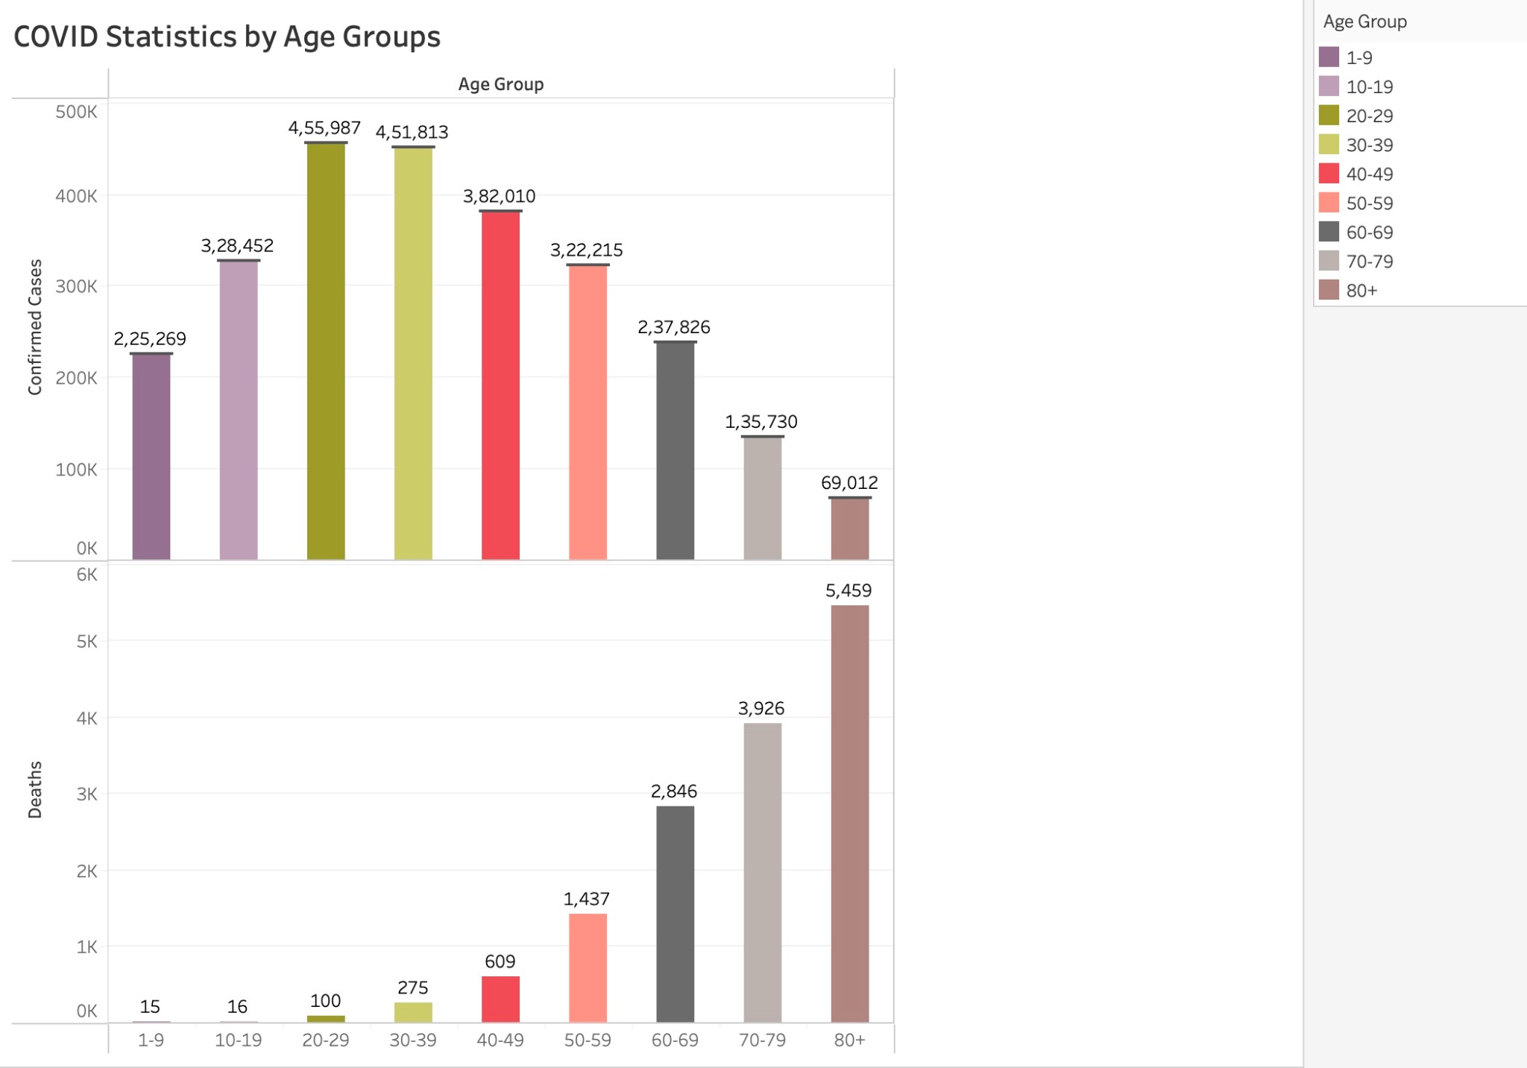
Hypothesis 5:
Individuals between 1-60 yrs of age have a lower fatality rate when compared to the 60+ population due to other underlying health conditions of the 60+ population.
Notes:
Explanation:

Slide 9
Conclusion
01
Vaccination is an effective tool in reducing the spread of COVID-19: As we can see through our analysis that COVID-19 vaccines are highly effective in preventing infections and reducing the severity of illness & Increasing vaccination rates can help to slow the spread of COVID-19.
02
Socioeconomic factors contribute to COVID-19 outcomes: People living in poverty or in crowded living conditions may be more likely to contract and spread COVID-19, as they may have limited access to healthcare or struggle to maintain social distancing. Addressing these socioeconomic factors can be an important step in controlling the spread of COVID-19.
03
Age is a significant factor in COVID-19 outcomes in Texas: Like other areas, older adults in Texas have a higher fatality rate from COVID-19 compared to younger adults.

